Slide 1

Climate Change and Health
Thomas B. Newman, MD, MPH
Professor Emeritus of Epidemiology & Biostatistics and Pediatrics
Chair SF Bay Area PSR Environmental Health Committee
Thanks to PSR and the Climate and Health Literacy Consortium, 2020
Notes:
OBJECTIVES:
1. List the main anthropogenic greenhouse gases, their approximate relative potency, and explain how they lead to global warming
2. Describe the mechanisms by which human health is affected by environmental change, for example through changes in disease vectors, exposure to extreme weather and fires, migration and food insecurity
3. Explain how the health impacts of environmental change are distributed unequally within and between populations and the disparity between those most responsible and those most affected by change
4. Describe how individuals and healthcare systems can reduce their carbon footprints
5. List main effects of nuclear weapons, how their explosive power is measured, and ballpark estimates of current nuclear weapons arsenals and spending.

Slide 2
Global Warming Made Simple
It’s real
We’re causing it (unequally)
It’s bad for us (unequally)
There are things we can do
There are “co-benefits” to doing them
Notes:
From the Center for Climate Change Communication at George Mason University. I added "unequally" in both places.

Slide 3
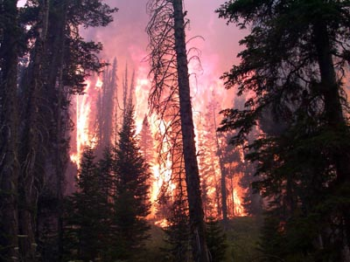
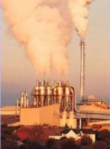
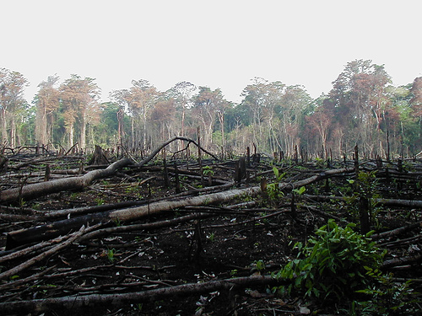
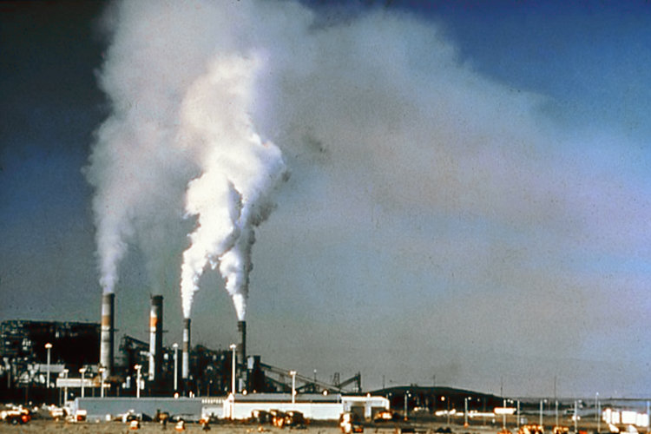
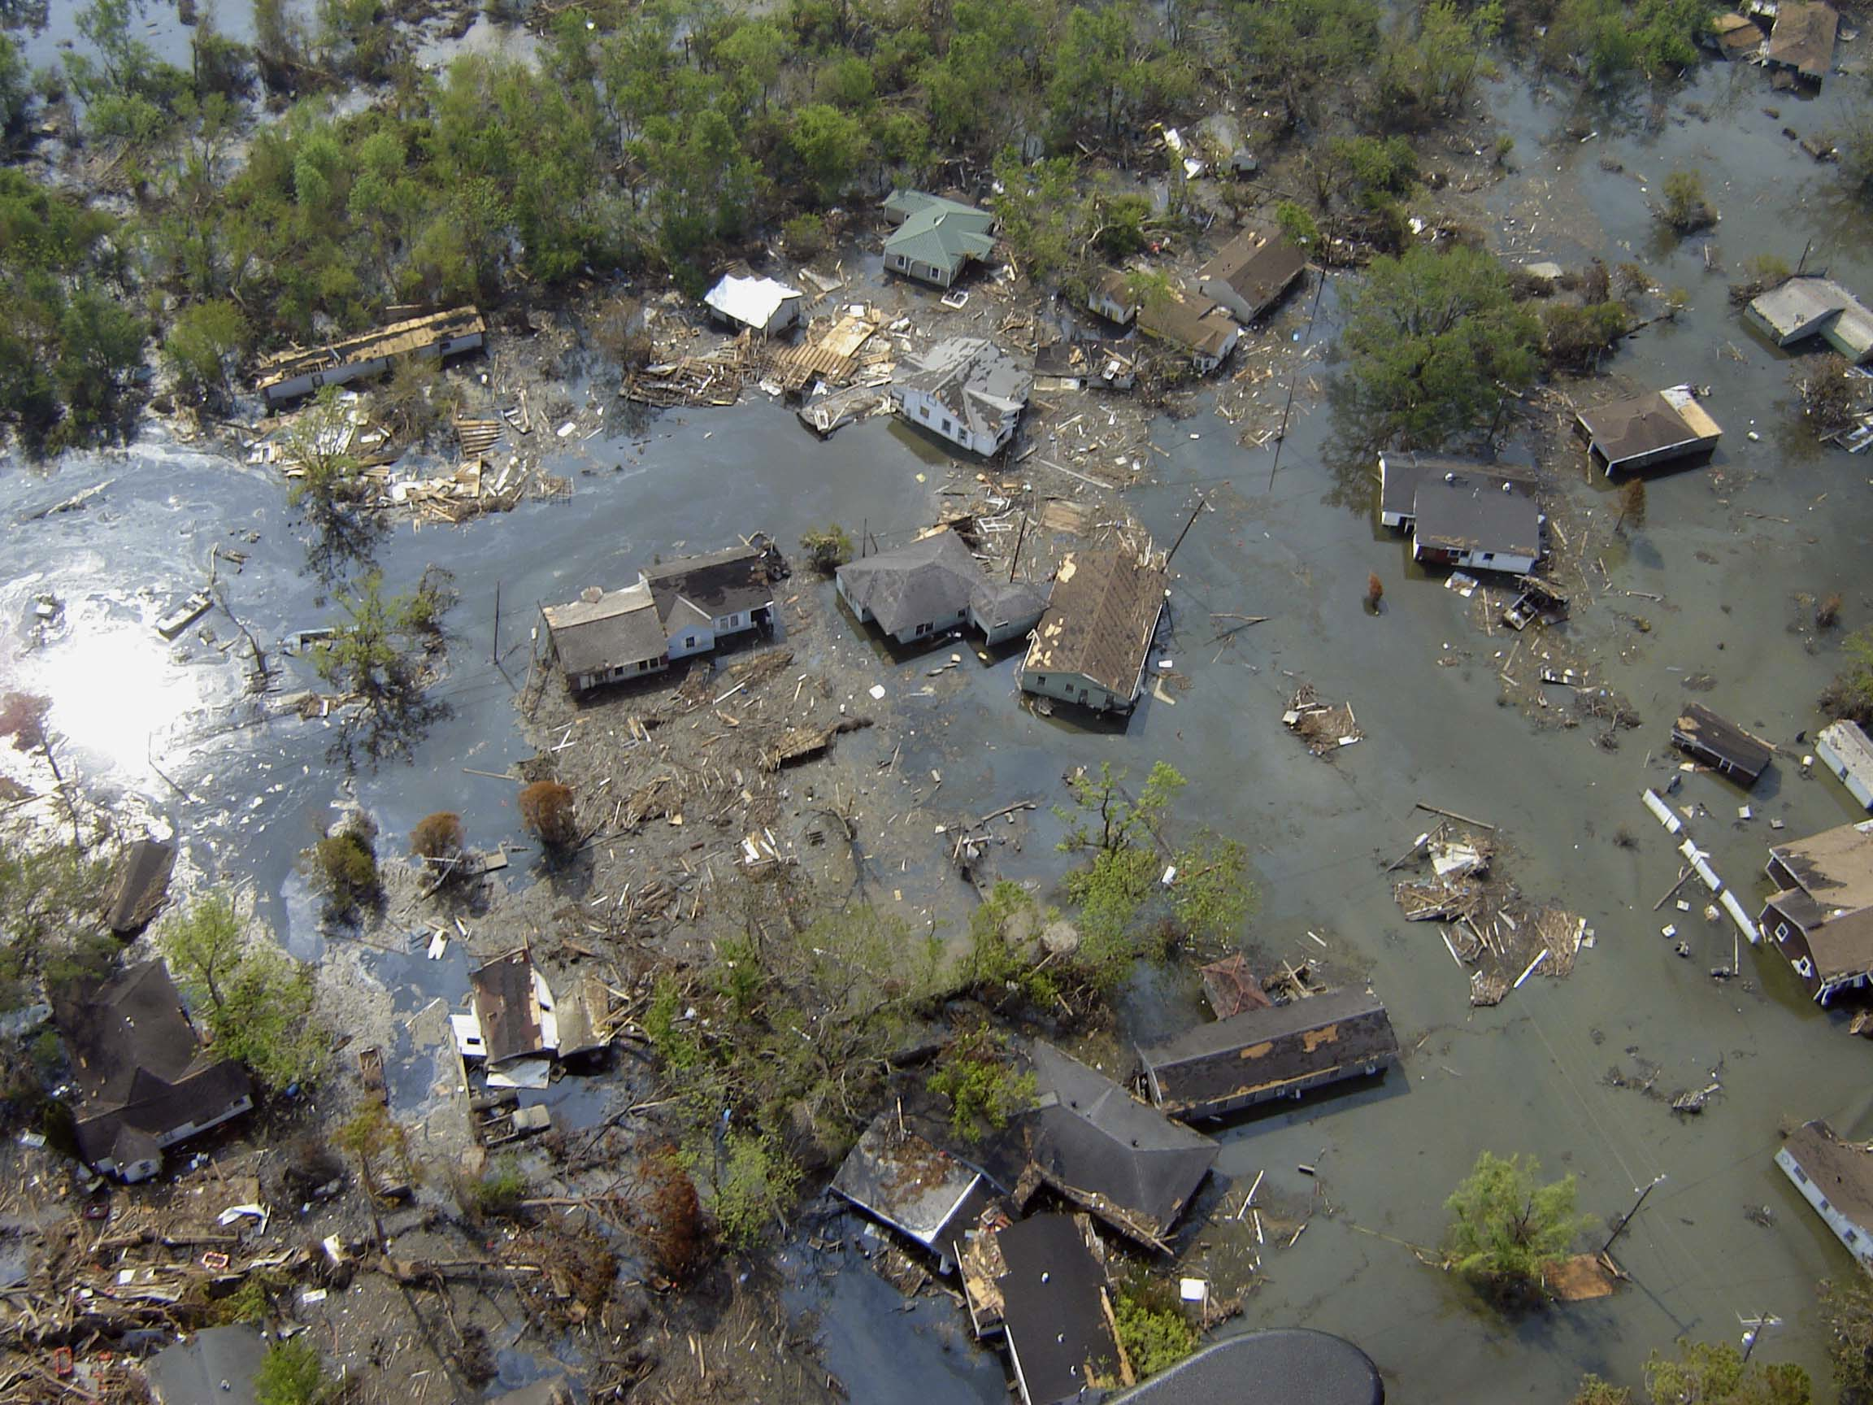
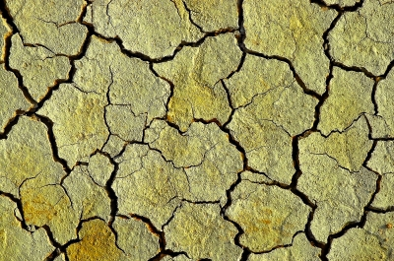
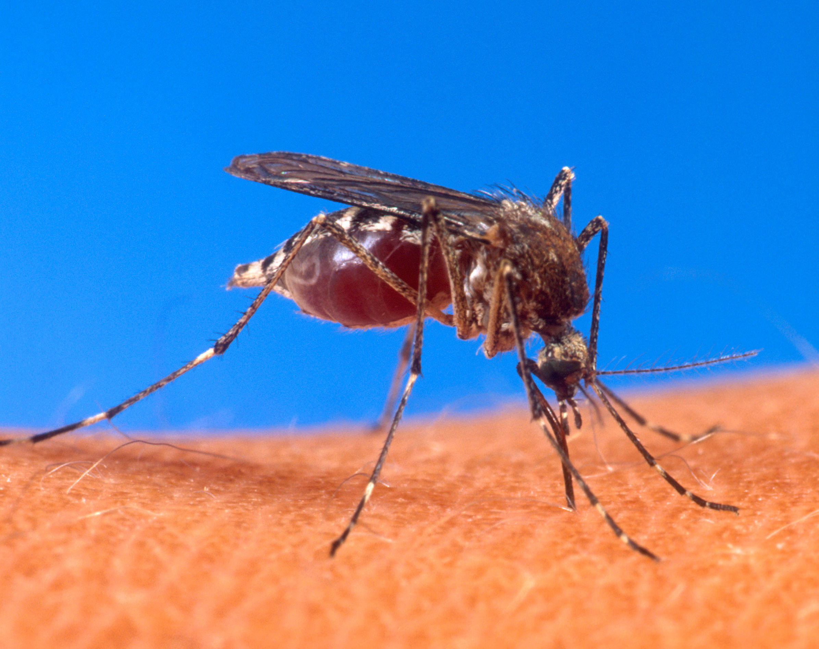
“Climate change could be the biggest global health threat of the 21st century… The impacts will be felt all around the world – and not just in some distant future but in our lifetimes and those of our children.”
--The Lancet, 11/09
Source: http://www.thelancet.com/climate-change
NOAA, Todd Heitkamp Wikimedia Commons
USEPA, Wikimedia Commons
Jami Dwyer, Wikimedia Commons
USDA, Wikimedia Commons
NOAA, Wikimedia Commons
Suat Eman, freedigitalphotos.net
Notes:
In November 2009, The Lancet and the University College London, UK released a released a report about the health impacts of climate change in future decades along with some solutions that can be implemented in the short and medium terms to mitigate these impacts.
This report called climate change the biggest global health threat of the 21st century. It examined the most serious direct and indirect consequences of climate change including “changing patterns of disease, water and food insecurity, vulnerable shelter and human settlements, extreme climate events, and population migration.”
Photo credits: Top from left to right:
-Wildfire, NOAA, Todd Heitkamp, Wikimedia Commons: http://commons.wikimedia.org/wiki/File:Waldbrand.jpg
-Air Pollution, EPA, Wikimedia Commons: http://commons.wikimedia.org/wiki/File:AirPollutionSource.jpg
-Deforestation: Jami Dwyer, Wikimedia Commons, http://commons.wikimedia.org/wiki/File:Lacanja_burn.JPG
-Air Pollution: National Parks Service, Wikimedia Commons: http://commons.wikimedia.org/wiki/File:Air_.pollution_1.jpg
Bottom left to right:
-Stegomyia aegypti mosquito, wikimedia commons, USDA: http://commons.wikimedia.org/wiki/File:Aedes_aegypti_biting_human.jpg
-Port Sulphur Louisiana after Hurricane Katrina, NOAA: http://commons.wikimedia.org/wiki/File:Katrina-port-sulphur-la-2005.jpg
-Erosion: Suat Eman, freedigitalphotos.net, http://www.freedigitalphotos.net/images/Uncategorised_g43-Erosion_p1877.html

Slide 4

Reinsurance companies insure insurance companies
Source: https://www.munichre.com/en/risks/climate-change-a-challenge-for-humanity.html
Notes:
19 of the 20 warmest years since 1880 have been since 2020

Slide 5
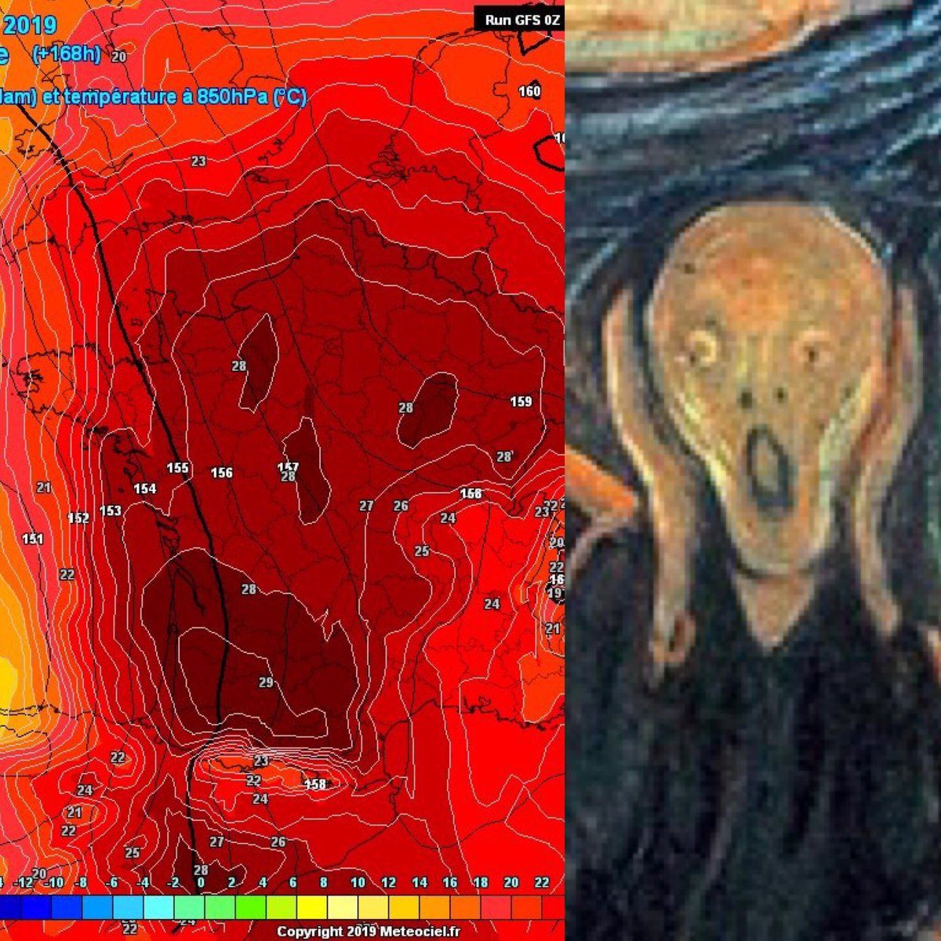
A 'screaming' weather map basically captures France's extreme heat
https://www.cnn.com/2019/06/26/europe/france-heat-map-intl/index.html
Notes:
https://www.cnn.com/2019/0.
(CNN)France is in the sweaty grasp of a hot weather phenomfootprint as la canicule -- and forecasters are running out of ways to describe both its immediate danger and ominous long-term significance.
Last week, meteorologist Ruben Hallali found an apt metaphor in this image: a weather forecast model for Thursday, June 27, whose patterns of temperatures across France just happened to create the image of a screaming skull.
6/26/europe/france-heat-map-intl/. Painting is Edvard Munch The Scream

Slide 6
Global Warming Made Simple
It’s real
We’re causing it (unequally)
It’s bad for us (unequally)
There are things we can do
There are “co-benefits” to doing them

Slide 7
Root Cause #1: Global Population
https://ourworldindata.org/world-population-growth Accessed 2019-1228

Slide 8
Root cause #2: Fossil fuels gas
5 × higher population since 1850
4 × higher energy use per capita =
20 × increase in energy
Kennedy, Donald and the Editors of Science Magazine, State of the Planet 2008-2009
Hydro + means hydro power plus renewables besides biomass
EJ= Exajoules = 10¹⁸ Joules
Notes:
The growth of the world’s population and prosperity (5-fold increase in population and a 4-fold increase in energy usage per person) over the past 150 years led to a 20-fold increase in energy use, the principal source of CO2 emissions.
Growth rate from 1850-1950 was 1.45%/yr, driven mainly by coal.
From 1950-2000 it was 3.15%/yr, driven mainly by oil & natural gas.
EJ (on the y axis) stands for exajoule. It is a Unit of energy equivalent to 10^18 joules and often used as unit of measure for world annual energy use.
Source: Kennedy, Donald and the Editors of Science Magazine, State of the Planet 2008-2009, Science Magazine
http://books.google.com/books?id=dr3Mn__YCp8C&pg=PA9&lpg=PA9&dq=world+energy+consumption+1850-2000&source=bl&ots=q9rOaYq7Gj&sig=pACLCNDOd_yAYW1pf0t3wdz0rvM&hl=en&ei=7TCuS7SKLYLQsgOJjs38Cw&sa=X&oi=book_result&ct=result&resnum=7&ved=0CCkQ6AEwBg#v=onepage&q=&f=false

Slide 9
CO₂ and Temperature, Last 800K Years
National Academy of Sciences, 2012
Notes:
Source 1 for top image: Lüthi, D., M. Le Floch, B. Bereiter, T. Blunier, J.-M. Barnola, U. Siegenthaler, D. Raynaud, J. Jouzel, H. Fischer, K. Kawamura, and T. F. Stocker. 2008. High-resolution carbon dioxide concentration record 650,000-800,000 years before present. Nature 453(7193):379-382, doi: 10.1038/nature06949.
Source 2 for bottom image: Jouzel, J., V. Masson-Delmotte, O. Cattani, G. Dreyfus, S. Falourd, G. Hoffmann, B. Minster, J. Nouet, J. M. Barnola, J. Chappellaz, H. Fischer, J. C. Gallet, S. Johnson, M. Leuenberger, L. Loulergue, D. Luethi, H. Oerter, F. Parrenin, G. Raisbeck, D. Raynaud, A. Schilt, J. Schwander, E. Selmo, R. Souchez, R. Spahni, B. Stauffer, J. P. Steffensen, B. Stenni, T. F. Stocker, J. L. Tison, M. Werner, and E. W. Wolff. 2007. Orbital and millennial Antarctic climate variability over the past 800,000 years. Science 317(5839):793-797.
From https://nas-sites.org/americasclimatechoices/more-resources-on-climate-change/climate-change-lines-of-evidence-booklet/evidence-impacts-and-choices-figure-gallery/figure-14/

Slide 10
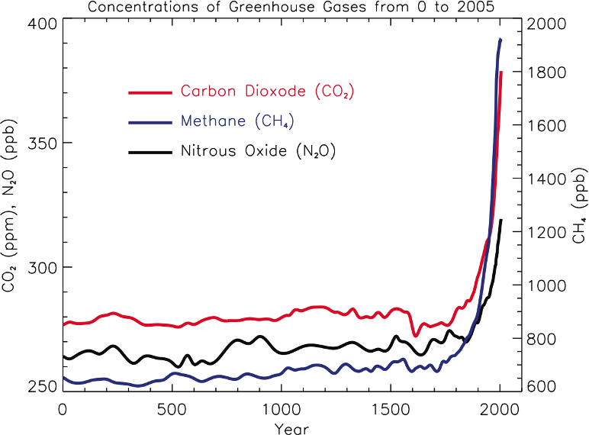
Source: IPCC, 2007
Not just CO₂
GWP*=1
GWP=86/34
GWP=268/298
*Global Warming Potential (relative to CO₂): 20/100-year horizon
Notes:
IPCC CAPTION READS: FAQ 2.1, Figure 1. Atmospheric concentrations of important long-lived greenhouse gases over the last 2,000 years. Increases since about 1750 are attributed to human activities in the industrial era. Concentration units are parts per million (ppm) or parts per billion (ppb), indicating the number of molecules of the greenhouse gas per million or billion air molecules, respectively, in an atmospheric sample. (Data combined and simplified from Chapters 6 and 2 of this report.)
GWP figures added by TN, from 2007 IPCC AR4 p212, based on 100-year time horizon via Wikipedia
Figure from: http://www.ipcc.ch/pdf/assessment-report/ar4/wg1/ar4-wg1-chapter2.pdf accessed 4/2/11
Human activities result in emissions of four principal green- house gases: carbon dioxide (CO2), methane (CH4), nitrous oxide (N2O) and the halocarbons (a group of gases containing fluorine, chlorine and bromine). These gases accumulate in the atmosphere, causing concentrations to increase with time. Significant increases in all of these gases have occurred in the industrial era (see Figure 1)…
• Carbon dioxide has increased from fossil fuel use in transportation, building heating and cooling and the manufacture of cement and other goods. Deforestation releases CO2 and reduces its uptake by plants. Carbon dioxide is also released in natural processes such as the decay of plant matter.
• Methane has increased as a result of human activities related to agriculture, natural gas distribution and landfills. Methane is also released from natural processes that occur, for example, in wetlands. Methane concentrations are not currently increasing in the atmosphere because growth rates decreased over the last two decades.
Nitrous oxide is also emitted by human activities such as fertilizer use and fossil fuel burning. Natural processes in soils and the oceans also release N2O.
GWP of Methane: see https://www.scientificamerican.com/article/how-bad-of-a-greenhouse-gas-is-methane/ accessed 3/18/18
https://en.wikipedia.org/wiki/Global_warming_potential#cite_note-8

Slide 11
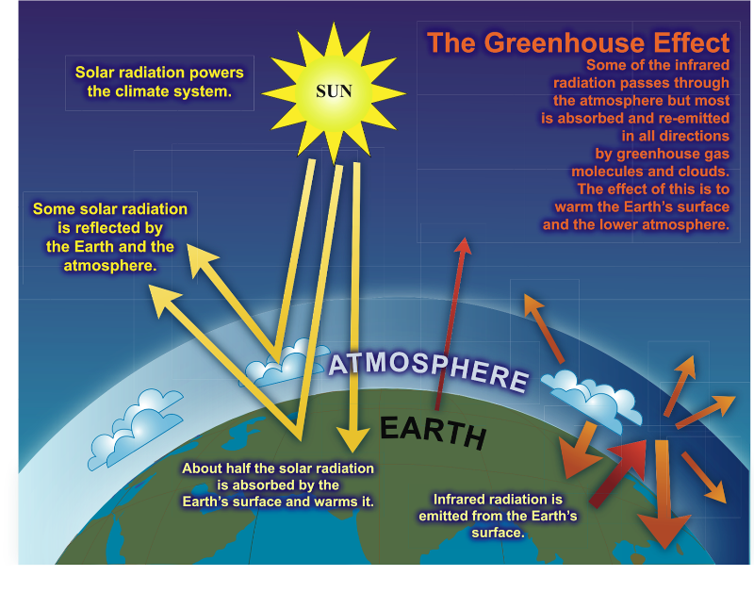
Source:
http://www.global-greenhouse-warming.com/what-is-the-greenhouse-effect.html
Notes:
The Earth has a natural temperature control system. Certain atmospheric gases, such as water vapor, CO₂, ozone, methane and nitrous oxide (N₂O) are critical to this system and are known as greenhouse gases. On average, about one third of the solar radiation that hits the earth is reflected back to space. Of the remainder, some is absorbed by the atmosphere, but most is absorbed by the land and oceans. The Earth's surface becomes warm and as a result emits infrared radiation. The greenhouse gases trap the infrared radiation, thus warming the atmosphere.
More familiar than a greenhouse is a car on a summer day with the windows shut.
Greenhouse gases act as a blanket to keep the earth warm.
Source:
http://www.global-greenhouse-warming.com/what-is-the-greenhouse-effect.html accessed 3/9/17
The IPCC estimates warming under different scenarios of Radiative Forcing (RF), which is measured in watts per meter squared. Radiative forcing quantifies net effects of GHG on the energy balance of the planet. Estimates are relative to 1750; total RF in 2011 was 2.29

Slide 12
Root Cause #3: Market Failure
"Climate change is a result of the greatest market failure the world has seen…The problem of climate change involves a fundamental failure of markets: those who damage others by emitting greenhouse gases generally do not pay.”
  Stern Review on the Economics of
  Climate Change
Notes:
https://www.theguardian.com/environment/2007/nov/29/climatechange.carbonemissions

Slide 13
Climate Change Models
Best science summary from Intergovernmental Panel on Climate Change (IPCC)
5th Assessment Report (AR-5) released 10/1/13: 130 countries, 450 lead authors, 2500 expert reviewers, all volunteers
Peer review process - high level of transparency and scrutiny
Google “IPCC”
Notes:
IPCC – Established in 1988 by the World Meteorological Organization and the United Nationals Environment Programme.
It is an inter-governmental scientific body that evaluates the risks of climate change caused by human activities. The IPCC bases its scientific assessments on peer reviewed research and publications, is reports are the most widely cited in climate change literature and it is considered nationally and internationally to be the most authoritative voice on climate change science and causes. The IPCC has released comprehensive reports in 1990, 1996, 2001 and 2007. It is currently writing a fifth assessment report: Climate Change 2014.
The IPCC credibility comes from the extensive transparent and iterative peer review process that is more exhaustive and comprehensive than scientific journals. Anyone can become a reviewer, but pledge confidentiality. See http://www.huffingtonpost.com/2012/12/14/leaked-ipcc-report_n_2300558.html#slide=1833760.
In the review process, if major differences in opinions arise, lead authors meet with the contributors and editors to discuss and resolve the differences.
Represents a multitude of expert opinions, including skeptics and people from all sides of the political spectrum. NGOs can participate as observers, climate change contrarians are contributing authors and advisors, industry representatives (ExxonMobil, Electric Power Research Institute), environmental scientists (Environmental Defense, Natural Resources Defense Council)
Sources:
Union of Concerned Scientists, http://www.ucsusa.org/global_warming/science_and_impacts/science/ipcc-backgrounder.html
IPCC, http://www.ipcc.ch/organization/organization.htm
AR-5

Slide 14
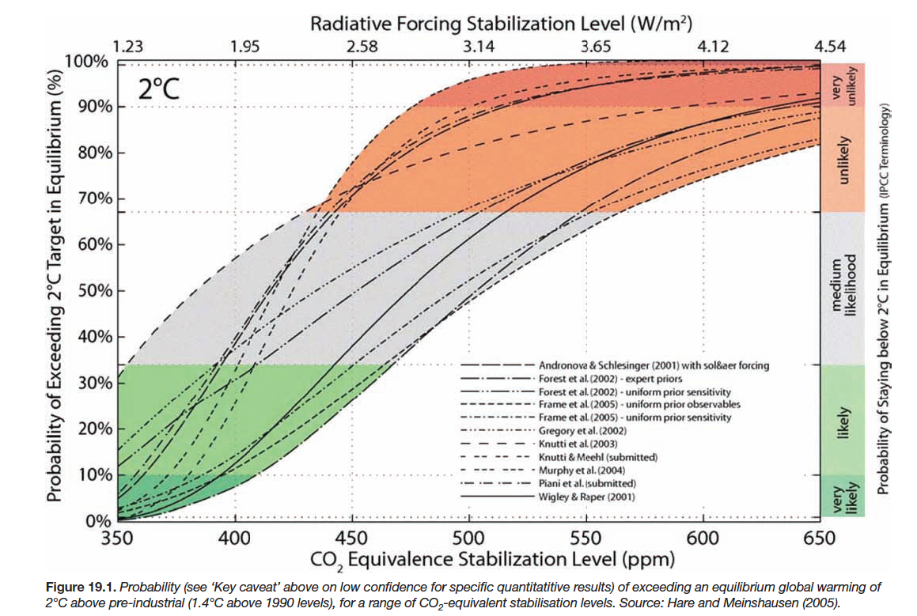
Climate change models
= 3.6° F
Notes:
TN: This slide shows how the IPCC considers a range of estimates from different models, in this case about the probability of a > 2 degree C increase in average temperature and the level of CO₂. (Universal agreement in Copenhagen that >2 degree C rise would be catastrophic)
TO avoid risking this level of potentially catastrophic warming (at > 10%), we need to keep that below 350 ppm, hence the organization www.350.org.
Source: IPCC AR-4, accessed 3/9/17 https://www.ipcc.ch/publications_and_data/ar4/wg2/en/ch19s19-4-2-2.html
Radiative forcing is measured in watts per m^2, is the difference between energy coming in and radiated back out. It is defined relative to pre-industrial (1750) levels.

Slide 15
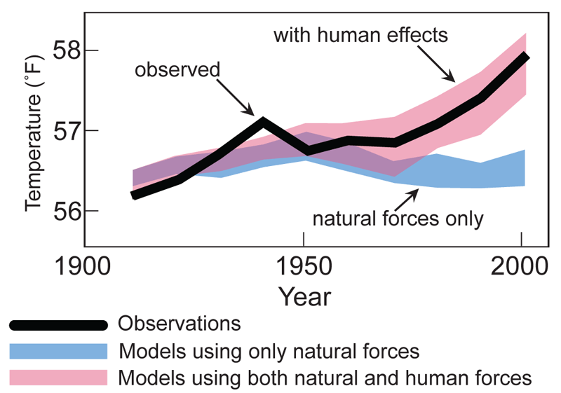
Global Average Temperature Models
https://www.ncdc.noaa.gov/monitoring-references/faq/indicators.php
Notes:
From: https://www.ncdc.noaa.gov/monitoring-references/faq/indicators.php, then click on "human influence" accessed 3/30/20.
TN: We use models to predict the weather (short term) and the climate (long term). We then can see how well the models fit; if the models don’t fit, it means there is something going on that isn’t in the model. When we look at what has been happening to the climate, models that include human activities fit, and those with natural forces only do not.
NOAA = National Oceanic and Atmospheric Administration
NOAA's National Centers for Environmental Information (NCEI) is responsible for preserving, monitoring, assessing, and providing public access to the Nation's treasure of climate and historical weather data and information

Slide 16
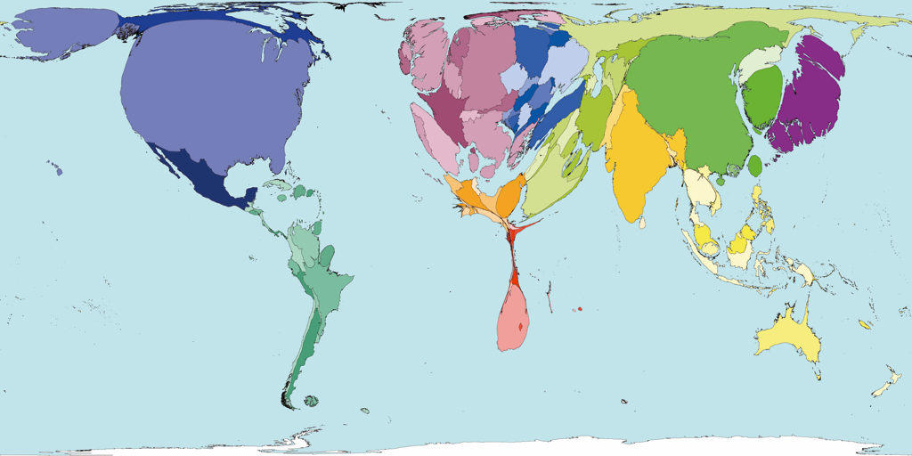
We are causing it (unequally)…
USA: 4% of world’s population, 25% of greenhouse gas emissions
Carbon emissions, 2000
http://www.worldmapper.org/display.php?selected=295
Notes:
Some of us are much more responsible for the warming than others. In the United States, we are responsible for one-fourth of all greenhouse gas emissions, worldwide.
China just passed the US as the biggest overall greenhouse gas polluter, but China has 4 people for every one person in the US. This means, on a per person basis, the average American still creates nearly 4 times more greenhouse gas pollution that does the average Chinese.
The map you see here, from 2000, is a representation of which countries are contributing most to the dangerous warming of our planet. You will immediately notice the enlarged size of the US here, in comparison to what you would normally expect to see.

Slide 17
Global Warming Made Simple
It’s real
We’re causing it (unequally)
It’s bad for us (unequally)
There are things we can do
There are “co-benefits” to doing them
Notes:
This slide, particularly, adapted from Ed Maibach Center for Climate Change Communication
#1. Global warming is real.
#2. We’re causing it.
#3. It’s a grave threat to us, especially to our children and their children.
#4 There are things we can do
#5 There are other good raesons to do almost all of them
We’re going to talk about all of these things today, but we’re going to spend most of our time talking about the 3rd point – the fact that global warming is very bad for people, not just bad for plants, penguins and polar bears – and the 4th point – that we can solve this problem -- because my mission as a public health professional is to help create a community, and a world, in which we and our children, can all live as healthfully as possible. For that to remain true, there are some important steps we are going to have to take.
Finally, I think this last point -- co-benefits– is very important. By that I mean that many of the steps we need to take would be good things to do even if they weren’t necessary to reduce the impact of global climate change.

Slide 18
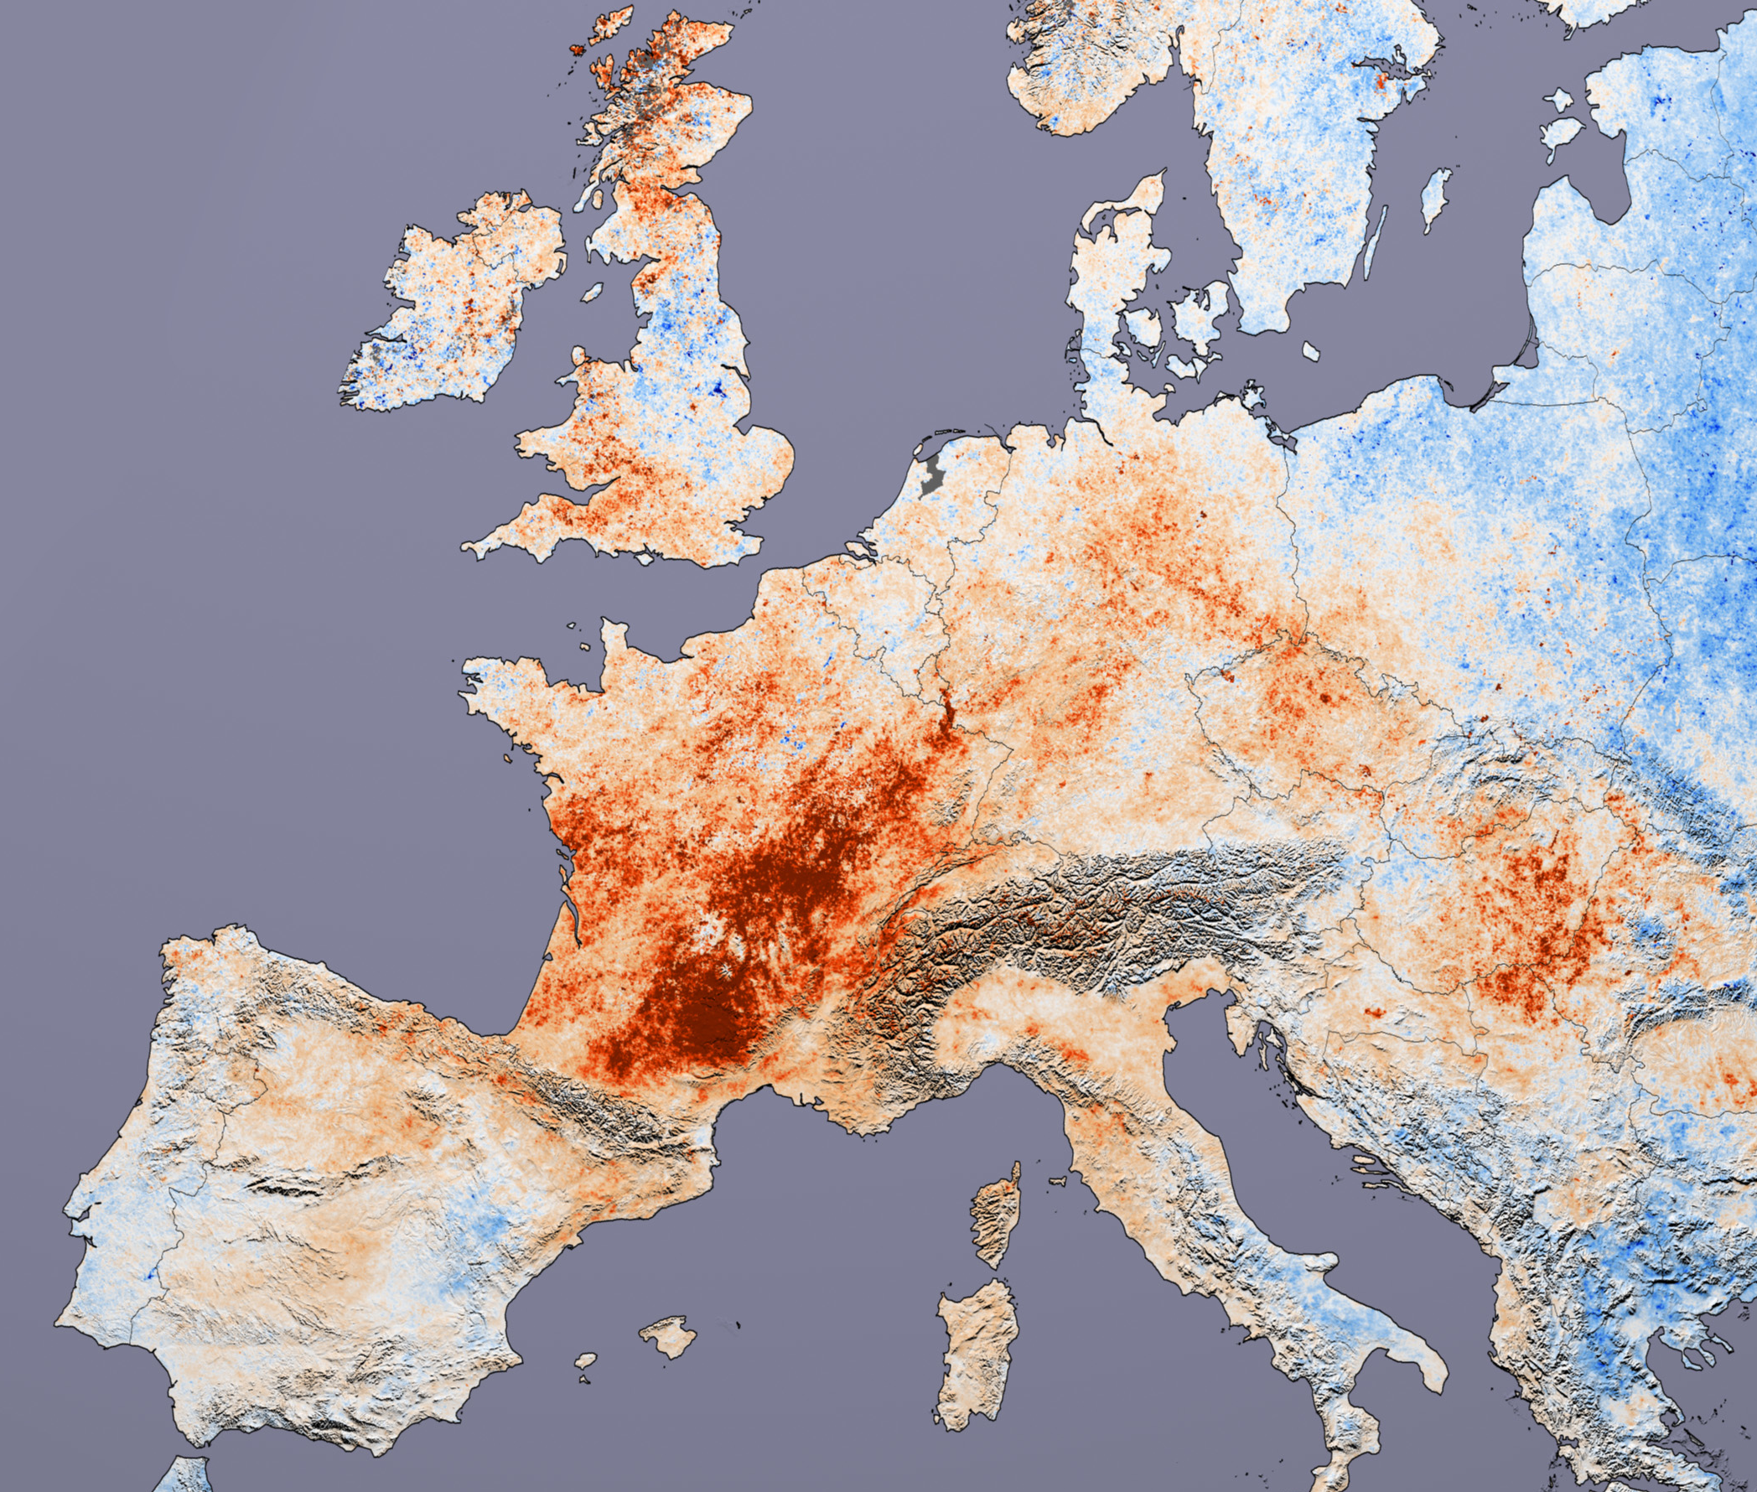
Heat Waves
2003 European heat wave¹
  Excess deaths > 80,000
2010 Eastern Europe and Russian heat wave²
  broke 500-year temperature records
  55,000 excess deaths in Russia alone
2017 San Francisco’s hottest day ever recorded (9/1, 106 degrees F)³
  Moffitt hospital no air conditioning!
NASA
1. Robine JM et al. 2003 Heatwave project.
2. Barriopedro et al. Science 2011;332:220; http://www.reuters.com/article/us-russia-heat-deaths-idUSTRE69O4LB20101025
3. www.washingtonpost.com/news/capital-weather-gang/wp/2017/09/01/san-francisco-smashes-all-time-record-high-temperature-hits-106-degrees/
NASA
Notes:
Ref for excess deaths in Europe: http://ec.europa.eu/health/ph_projects/2005/action1/docs/action1_2005_a2_15_en.pdf
California has already begun to feel the effects of extreme heat.
https://www.ncbi.nlm.nih.gov/pubmed/19165388 Environ Health Perspect. 2009 Jan; 117(1): 61–67
For example, during the California heat wave of 2006:
Daytime temperatures went above 100 degrees for two weeks
We experienced record nighttime highs
California Photo: NASA, http://www.nasaimages.org/luna/servlet/detail/nasaNAS~10~10~67510~172326:Springtime-Heat-Wave-Bakes-Southern
Europe Photo: http://images.google.com/imgres?imgurl=http://veimages.gsfc.nasa.gov/18752/modis_lst_europe_2001-2003_lrg.jpg&imgrefurl=http://visibleearth.nasa.gov/view_rec.php%3Fid%3D18752&usg=__lTihKPia6xSwVQ5pFL2vLBVwJ7Q=&h=1800&w=2124&sz=1399&hl=en&start=32&um=1&itbs=1&tbnid=kXYUrQN27hFprM:&tbnh=127&tbnw=150&prev=/images%3Fq%3Dheat%2Bwave%26start%3D18%26um%3D1%26hl%3Den%26client%3Dsafari%26sa%3DN%26rls%3Den%26as_rights%3D(cc_publicdomain%257Ccc_attribute%257Ccc_sharealike%257Ccc_noncommercial%257Ccc_nonderived)%26as_st%3Dy%26ndsp%3D18%26tbs%3Disch:1
SF Record: http://www.latimes.com/local/lanow/la-me-ln-california-heat-wave-weekend-20170901-story.html
CA Heat graphic from LA Times story above

Slide 19
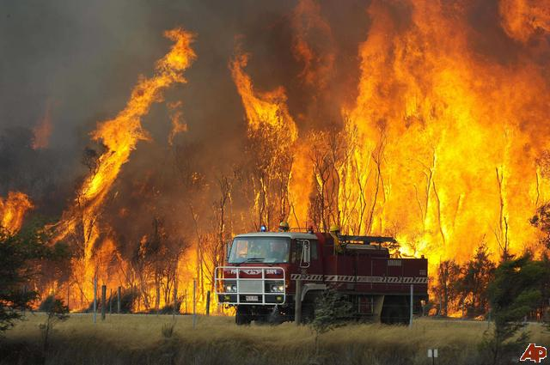
Increase in Wildfires
Increased particulate pollutants and ozone
Most vulnerable: elderly, children, people with respiratory illnesses
2018 California wildfires worst ever recorded
  101 DEATHS
  Record poor air quality
Santa Rosa, 2017
Photos: FEMA, Florida Division of Forestry
Notes:
A fire truck moves away from out of control flames from a bushfire in the Bunyip Sate Forest near the township of Tonimbuk, 125 kilometers (78 miles) west of Melbourne, Saturday, Feb. 7, 2009. Walls of flame roared across southeastern Australia, razing scores of homes, forests and farmland in the sunburned country's worst wildfire disaster in a quarter century. (AP Photo) http://newshopper.sulekha.com/australia-wildfires_photo_665325.htm
Photo 2 from Santa Rosa fire https://finance.yahoo.com/news/3-key-reasons-explain-massive-001700431.html
http://www.sciencemag.org/content/313/5789/940.full
4x increase in major fires, 6x increase in area burned in Western US, 1987-2005 vs. 1970-86. *Westerling et al. Science 2006; 313:940-943

Slide 20
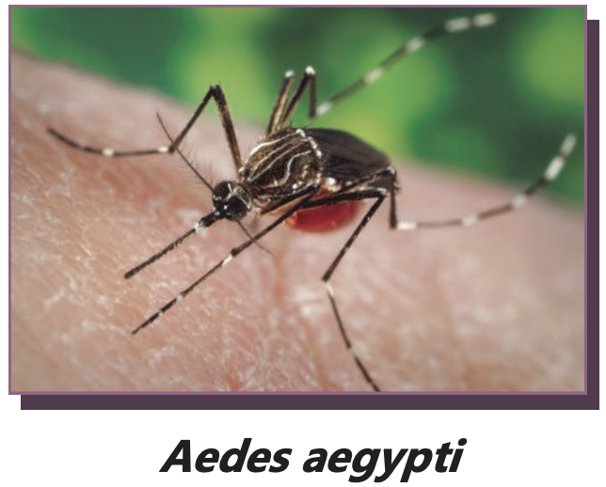
Infectious Diseases
Increased geographical range and risk of vector-borne diseases
We are now seeing Aedes (non-native) mosquitoes in California. (Mnemonic: CD YZ)
  Chicungunya
  Dengue
  Yellow Fever
  Zika
Waterborne illnesses due to flooding, societal disruption (e.g., cholera)
Notes:
From the center for Climate Change Communication
Increased temperature, rainfall variability and altered dynamics of reservoir populations are predicted to increase the transmission of some zoonotic diseases. Changes may permit establishment of novel imported infectious diseases in regions that were previously unable to support endemic transmission.
• Changes likely to vary geographically.
• Increased temperature shortens pathogen development time in vectors. This increases the duration of infectiousness, allowing for prolonged periods of transmission to humans.
• Changes in climate may expand the geographic range and abundance in both vectors and reservoir hosts.
• Warming and altered rainfall patterns may increase populations of reservoir animals and their predators (e.g., rabbits and foxes).
• Early onset of favorable transmission conditions may prolong transmission cycles.
• Flooding provides breeding habitats for vectors and reservoir hosts, increasing their abundance and geographic range, which may lead to more frequent outbreaks of diseases.
• Increased risk of travel-associated illnesses.
- Mass migrations of climate refugees could increase human-to-human transmissions
Source: Greer, Ng, Fisman, CMAJ 2008;178(6):715-22
Dengue: https://www.ncbi.nlm.nih.gov/pmc/articles/PMC3314069/
Chikungunya: “A viral illness that is spread by the bite of infected mosquitoes. The disease resembles dengue fever, and is characterized by severe, sometimes persistent joint pain (arthritis) as well as fever and rash. It is rarely life-threatening. http://www.searo.who.int/en/Section10/Section2246.htm
Tularemia: a bacterial disease characterized by skin ulcers, swollen and painful lymph glands, inflamed eyes, soar throat, mouth sores, diarrhea or pneumonia. People can be infected through infected insect bites (ticks and deerflies), by handling infect animals, by eating or drinking contaminated food or water, or by inhaling airborne bacteria. It can be treated by antibiotics. http://www.bt.cdc.gov/agent/tularemia/faq.asp
Dengue Fever: This viral disease is transmitted by mosquitoes. It can be fatal if unrecognized or not properly treated. Symptoms include high fever, severe headache, join pain. The disease is most prevalent in tropical regions. http://www.cdc.gov/dengue/fAQFacts/index.html
Malaria:
It’s not just the direct, highly visible impacts of flooding, drought, hurricanes and heat waves that comprise the health threats posed by global warming. Rising temperatures and changing weather patterns will also have a number of secondary impacts that could jeopardize human well-being in regions across the globe.
The spread of infectious diseases is one example of such secondary impacts. Mosquitoes, which can carry malaria and other diseases, are highly sensitive to temperature changes. Higher temperatures boost their reproductive and biting rates, lengthen their breeding season, and shorten the time it takes for the malarial pathogen to mature to an infectious state. Increasing temperatures may also expand the viable range of mosquitoes to higher elevations and more northern latitudes, potentially putting at risk previously unexposed populations.
Along with rising temperatures, changes in precipitation can also lead to the spread of malaria, with floods potentially triggering outbreaks as they leave behind vector breeding sites. (1)
Each year, approximately 500 million people are infected with malaria, of which approximately 1 million die from the disease.(2) As global warming continues, some estimates predict that as many as 90 to 200 million additional people may be at risk of malaria by the later half of this century.(3)
References:
(1)Epstein PR. Climate Change and Human Health. New Eng J Med. 2005; 353(14): 1433-1436.
(2) Greenwood BM, Bojang K, Whitty C, Targett GAT. Malaria. Lancet. 2005; 365: 1487-1498.
(3) Van Lieshout M, Kovats RS, Livermore MT, Martens P. Climate Change and Malaria: Analysis of the SRES Climate and Socio-Economic Scenarios. Global Environmental Change. 2004; 14: 87 – 99
(4) Map: UNEP/GRID-Arendal. Climate change and Malaria, scenario for 2050. UNEP/GRID-Arendal Maps and Graphics Library. 2005. Available at: http://maps.grida.no/go/graphic/climate_change_and_malaria_scenario_for_2050. Accessed February 07, 2007.
(5) Figure: Epstein PR and Mills E (eds.) Climate Change Futures: Health, Ecological and Economic Dimensions. The Center for Health and the Global Environment, Harvard Medical School, 2005.
Dengue fever is also expected to increase in prevalence as a result of global warming. In 1990, approximately 30% of the world’s population, 1.5 billion people, lived in regions where the estimated risk of dengue transmission was greater than 50%. By 2085, an estimated 50% to 60% of the projected world population, 5-6 billion people, would be at risk of dengue transmission, compared with 3.5 billion people (or 30% of world population) if climate change did not occur.(1)
References:
(1) Hales S, de Wet N, Maindonald J, Woodward A. Potential Effect of Population and Climate Changes on Global Distribution of Dengue Fever: an Empirical Model. Lancet. 2002; 360: 830-834.
Photos:
CDC, Climate Change and Public Health, Vector Borne and Zoonotic Diseases: http://www.cdc.gov/climatechange/effects/vectorborne.htm
Tick: USDA, http://www.ars.usda.gov/is/graphics/photos/mar98/k8002-3.htm

Slide 21
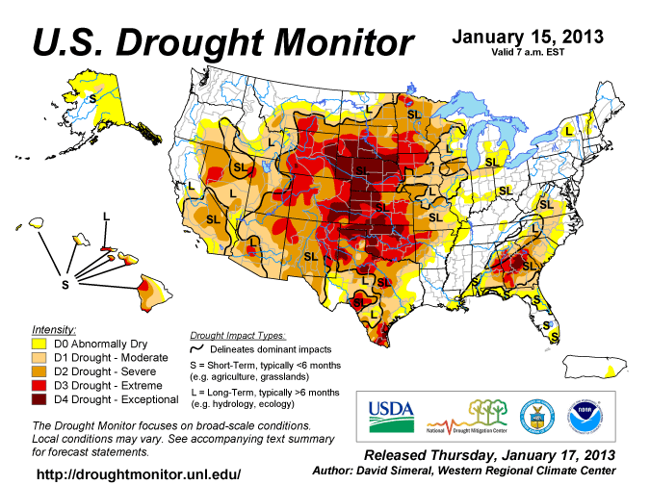
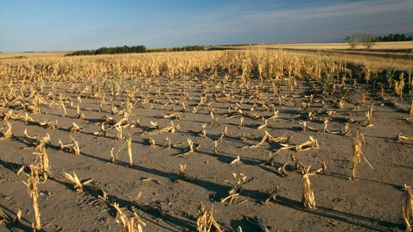
More Droughts
Loss of summer arctic cooling of Northern Hemisphere
Lower crop yields, food insecurity, malnutrition, disease, population displacement, armed conflict
Notes:
Photo: ABC news/Getty images, found at http://abcnews.go.com/blogs/technology/2012/07/whos-most-to-blame-for-global-warming/ 1/27/13

Slide 22
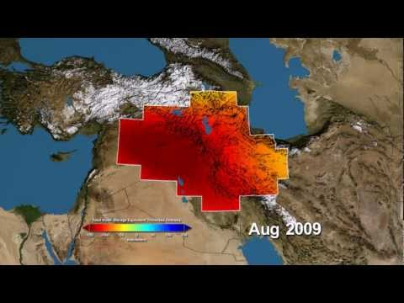
Without Water, Revolution
By THOMAS L. FRIEDMAN
NYT: May 18, 2013
TEL ABYAD, Syria — “…between 2006 and 2011, some 60 percent of Syria’s land mass was ravaged by the drought and, with the water table already too low and river irrigation shrunken, it wiped out the livelihoods of 800,000 Syrian farmers and herders…”
Satellites Reveal Depletion of a Vital Middle East Water Supply
By ANDREW C. REVKIN
NYT: February 12, 2013
Notes:
http://www.nytimes.com/2013/05/19/opinion/sunday/friedman-without-water-revolution.html?pagewanted=all&_r=0
I came here to write my column and work on a film for the Showtime series, “Years of Living Dangerously,” about the “Jafaf,” or drought, one of the key drivers of the Syrian war. In an age of climate change, we’re likely to see many more such conflicts.
“The drought did not cause Syria’s civil war,” said the Syrian economist Samir Aita, but, he added, the failure of the government to respond to the drought played a huge role in fueling the uprising. What happened, Aita explained, was that after Assad took over in 2000 he opened up the regulated agricultural sector in Syria for big farmers, many of them government cronies, to buy up land and drill as much water as they wanted, eventually severely diminishing the water table. This began driving small farmers off the land into towns, where they had to scrounge for work.
Because of the population explosion that started here in the 1980s and 1990s thanks to better health care, those leaving the countryside came with huge families and settled in towns around cities like Aleppo. Some of those small towns swelled from 2,000 people to 400,000 in a decade or so. The government failed to provide proper schools, jobs or services for this youth bulge, which hit its teens and 20s right when the revolution erupted.
Then, between 2006 and 2011, some 60 percent of Syria’s land mass was ravaged by the drought and, with the water table already too low and river irrigation shrunken, it wiped out the livelihoods of 800,000 Syrian farmers and herders, the United Nations reported. “Half the population in Syria between the Tigris and Euphrates Rivers left the land” for urban areas during the last decade, said Aita. And with Assad doing nothing to help the drought refugees, a lot of very simple farmers and their kids got politicized. “State and government was invented in this part of the world, in ancient Mesopotamia, precisely to manage irrigation and crop growing,” said Aita, “and Assad failed in that basic task.”

Slide 23
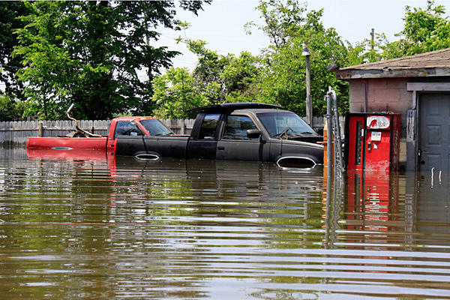
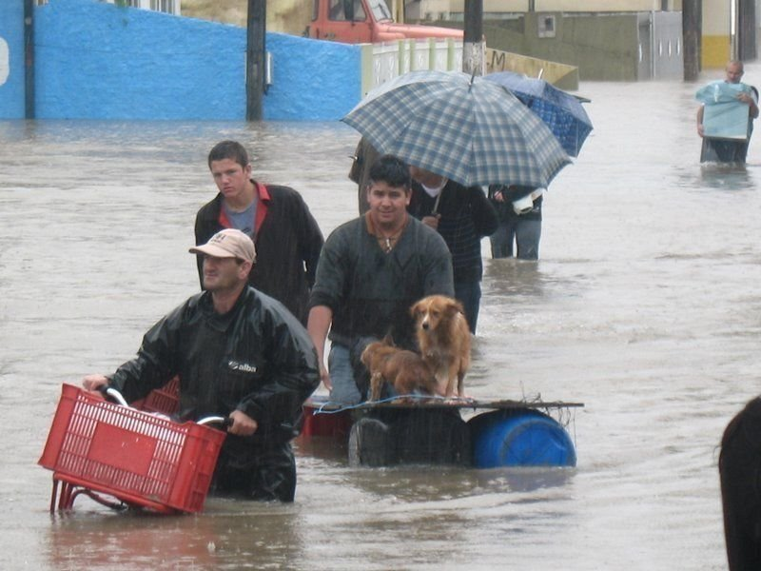
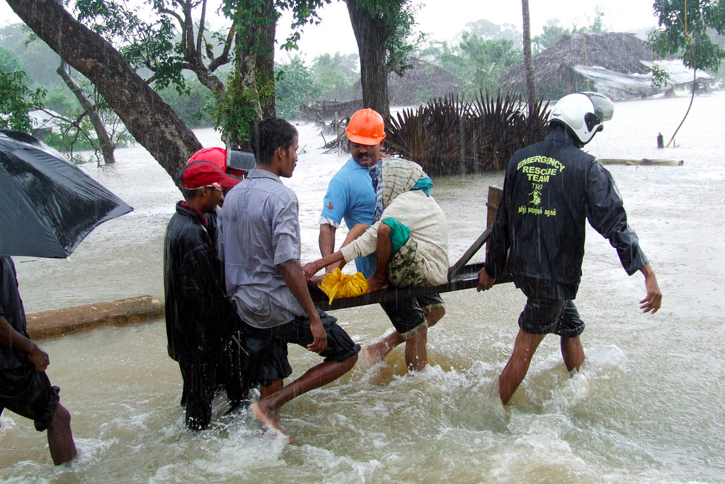
Increased Storms and Flooding
Direct injuries and deaths
Contaminated water supplies
Increased risk of infectious diseases
Long term psychological effects
Financial losses, poverty: 2017 U.S. Hurricane damage*:
  Harvey: $180 billion
  Irma: $ 175 billion
  Maria: $ 50 billion
*https://www.cnn.com/2017/10/10/weather/hurricane-nate-maria-irma-harvey-impact-look-back-trnd/index.html
Notes:
Reference New Orleans, Louisiana, Hurricane Katrina
Flooding will become more common. As global temperatures rise, the global water cycle is accelerated and the amount of water vapor in the atmosphere increases. The result is more intense downpours, even when total precipitation remains unchanged.
References:
(1)Millennium Ecosystem Assessment, 2005. Ecosystems and Human Well-being: Synthesis. Island Press, Washington, DC.
(2) Milly PCD, Wetherald RT, Dunne KA and Delworth TL. Increasing Risk of Great Floods in a Changing Climate. Nature (2002); 415: 514-517.
Photos (left to right):
Orkut images, Wikimedia Commons, http://commons.wikimedia.org/wiki/File:Itajai_floods.jpg
Trokilinochchi, Wikimedia Commons, http://commons.wikimedia.org/wiki/File:Woman_in_Sri_Lanka_rescued_during_monsoon_flooding.jpg
2017 Hurricane damage estimates from CNN: https://www.cnn.com/2017/10/10/weather/hurricane-nate-maria-irma-harvey-impact-look-back-trnd/index.html

Slide 24
Respiratory Disease, Asthma & Allergies
Longer pollen season with higher counts
Mold and mildew in houses after flooding
Smoke from fires → low air quality
Higher temperatures → higher ozone levels → increased respiratory mortality
Crowley RA. Climate Change and Health: A Position Paper of the American College of Physicians. Annals of Internal Medicine 2016;164:608-10
Jerrett et al. Long-Term Ozone Exposure and Mortality NEJM 2009;360:1085-90
Notes:
Crowley RA (2016). Climate Change and Health: A Position Paper of the American College of Physicians. Annals of Internal Medicine
Long-Term Ozone Exposure and Mortality
http://www.nejm.org/doi/full/10.1056/NEJMoa0803894

Slide 25
Psychological Effects
Post-traumatic stress disorder (e.g., after natural disasters)
Depression
"Eco-anxiety"

Slide 26
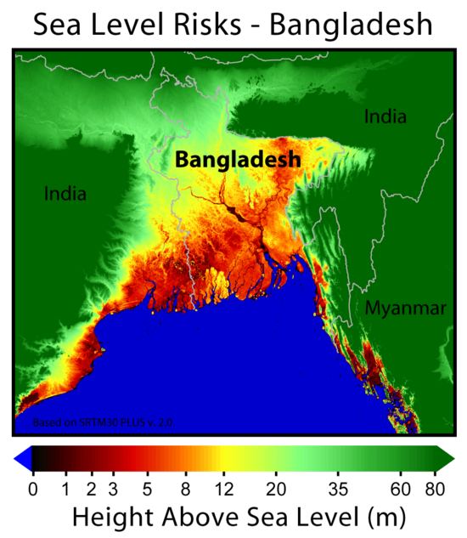
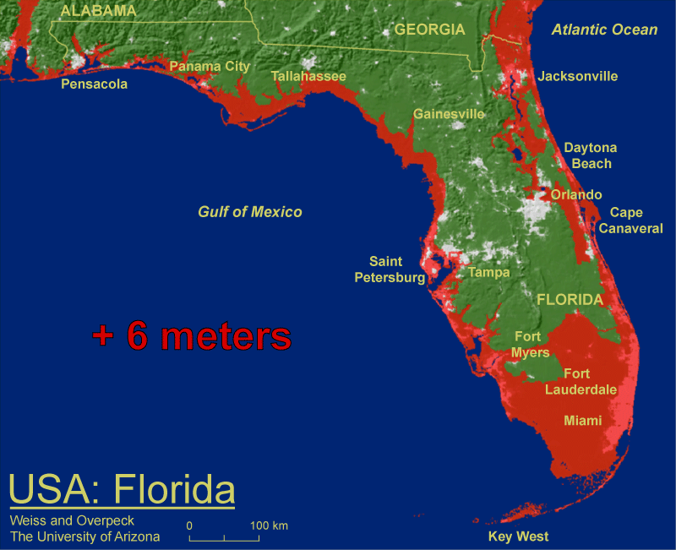
Sea Level Rise
More coastal flooding during storms
Saltwater intrusion into fresh water supplies
Population displacement, refugees, armed conflict
Over the last 3 million years when temps were 2-3° C higher, sea levels were 6 meters higher*
*IPCC AR-5
Notes:
From AR5: http://www.stopgreensuicide.com/Ch13_sea-level_WG1AR5_SOD_Ch13_All_Final.pdf. Florida picture: why 6 meters?
Paleo sea level records from warm periods during the last 3 million years provide medium-to-high 16confidence that global mean sea level was more than 6 m higher than present when global temperature 17was 2°C–3°C warmer than present. During the Last Interglacial Period, for the time interval in which 18global mean sea level was above present, the maximum 1000-year average rate of global mean sea level rise 19very likely exceeded 2.0 m kyr–1, likely exceeded 4.1 m kyr–1, and was unlikely to have exceeded 5.8 m kyr–1. 20Faster rates lasting less than a millennium cannot be ruled out. Because these periods give only a limited 21analogy for future anthropogenic climate change, we do not consider that they provide upper bounds for 22global mean sea level rise during the 21st century. [Chapter 5, 13.2.1, Figure 13.3]. Rise in AR-5 estimated at 29 to 82 cm (11” to 32”).
See also: https://arxiv.org/pdf/1211.4846.pdf
It’s not just increasingly intense precipitation events that will lead to more flooding in a warmer world. Rising sea levels will also lead to widespread coastal flooding as global warming progresses. Higher temperatures cause sea level rise by expanding ocean water, melting glaciers and small ice caps and provoking sections of Greenland and Antarctic ice sheets to melt.
Over the last century, sea level rose by about 4.5 to 8.5 inches, and the IPCC projects that global warming could cause an additional 7 to 23 inch rise in sea level by 2100 (“excluding rapid dynamical changes in ice flow” .(1) More recently, research published in the journal Science indicates that the recently observed accelerations in the melt and flow of land-based ice sheets in Greenland and Antarctica could contribute to a much more substantial sea level rise, ranging from 20 to 55 inches by the end of the century.(2) A rise of this magnitude would have serious implications for coastal cities and towns around the globe.
Even a rise in sea level within the range projected by the IPCC (40cm, or approximately 16 inches by 2080) would result in an increase in the number of people at risk of flooding by coastal storm surges from the current 75 million to 200 million people.(1)
Salt marshes, mangroves and other coastal wetland ecosystems that important habitats for many species will be greatly threatened by rising sea levels. These ecosystems are also vital in fishing, recreation and other economically important activities. (3)
Rising sea levels will increase the salinity levels in surface and ground water as a result of salt water intrusion. Not only will this harm plants and animals in estuaries, but it will also threaten sources of water for human consumption. (4)
References:
(1) IPCC. Climate Change 2007: The Physical Science Basis, Summary for Policymakers. Contribution of Working Group I to the Fourth Assessment Report of the Intergovernmental Panel on Climate Change. Available at: http://www.ipcc.ch
(2) Rahmstorf S. A Semi-Empirical Approach to Projecting Future Sea-Level Rise. Science; Published online December 14, 2006; 10.1126/science.1135456
(3) And (4) Coastal Zones and Sea Level Rise:
http://www.epa.gov/climatechange/effects/coastal/index.html
Photos: EPA: http://www.epa.gov/climatechange/effects/coastal/index.html
See also: http://www.miamiherald.com/news/state/florida/article12983720.html#storylink=cpy
State environmental officials ordered not to use the terms “climate change” or “global warming” in any government communications, emails, or reports.

Slide 27
Global Warming Made Simple
It’s real
We’re causing it (unequally)
It’s bad for us (unequally)
There are things we can do
There are “co-benefits” to doing them

Slide 28

Estimating Your Carbon Footprint
Many online calculators
Best ones include food, show effects of changes you can make, and are state-specific
Google “Carbon footprint calculator”
  (I recommend The Nature Conservancy site.)
  Also Google “Footprint Network”
Per capita US carbon footprint ~21 tons
Notes:
Graphic from http://www.carbonfootprint.com/calculator.aspx accessed 1/2/11
Nature conservancy site: http://www.nature.org/greenliving/carboncalculator/index.htm
Note EPA calculator does not include food or airplane travel! Focuses on little things you can do.
21 tons per person from https://www.epa.gov/ghgemissions/us-greenhouse-gas-inventory-report-1990-2014 accessed 3/10/17

Slide 29
Importance of Airplane Travel
1 East Coast round trip from California = 1-2 tons CO₂
Typical California per capita household electricity consumption ~ 3 tons CO₂
Reduce travel by
  Combining trips
  Skipping trips
  Videoconferencing, Skype, Zoom, etc.
Consider offsetting your travel
Notes:
http://www.arb.ca.gov/cc/ccc/ccc.htm
Higher estimates for travel factor in “radiative forcing”– the fact that GHG emitted at high altitude have a greater effect.
++++++++++++++++++++++++++ From http://www.pge.com/about/environment/calculator/assumptions.shtml accessed 1/2/11:
Average Per Capita CO₂ Emissions (Energy and Vehicle Use)Average Californian 22,941 lbs CO₂ per person Assumptions:
2005 California Per Capita Electricity Usage: 7,032 kWh (** 1644 total for T & J Newman)
2005 California Per Capita Natural Gas Usage: 422 therms
California Emissions Rate for Delivered Electricity: 0.879 lbs CO₂ per kWh
Emissions Rate for Natural Gas: 13.446 lbs CO₂ per therm
(So in California 5674 # CO2 from natural gas and 6181 # from electricity and
12,000 miles per year and 21 miles per gallon for average passenger vehicle – 11,0857 for driving = 5 tons
Burning 1 gallon of gasoline produces 19.4 lbs CO₂
Typical Californian:
~3 tons for electricity
~2.5 tons for natural gas
~5 tons for driving
~4 tons for food

Slide 30
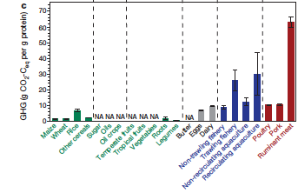
GHG footprint of foods per gram protein
Tilman D, Clark M. Nature, 2014; 515:518-22
Notes:
https://www.nature.com/articles/nature13959

Slide 31
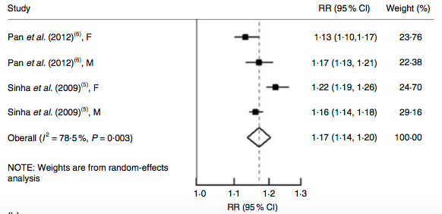
Co-benefit of eating less meat: Living longer
Fig. 3 Risk of all-cause mortality associated with each serving per day of total meat
Wang X et al. Red and processed meat consumption and mortality:
dose–response meta-analysis of prospective cohort studies. Public Health Nutrition 2016; 19:893-905
Notes:
Fig. 3 Risk of (a) all-cause mortality, (b) cardiovascular mortality and (c) cancer mortality associated with each serving per day of total meat.
I^2 indicates heterogeneity, suggesting differences between estimates are not due to chance. Conclusion that eating more meat is associated with higher mortality is the same in all studies listed.

Slide 32

https://sustainability.ucsf.edu/3.690

Slide 33
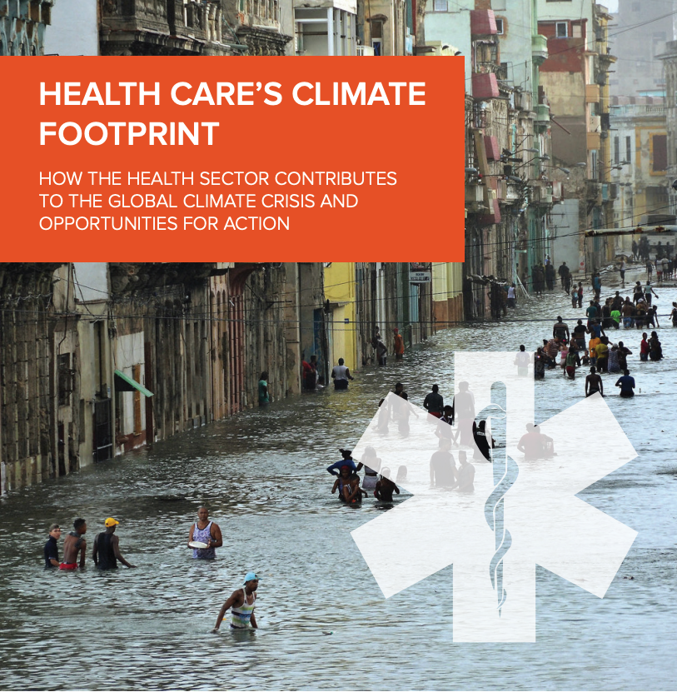
4.4% of worlds greenhouse gas emissions
If healthcare were a country, it would be the 5th largest producer of GHG
Notes:
https://noharm-global.org/sites/default/files/documents-files/5961/HealthCaresClimateFootprint_090619.pdf

Slide 34
Improve Healthcare Value
Discretionary funding for ANYTHING (including infrastructure, conservation, renewable energy) severely constrained by healthcare costs
Trying to reduce the environmental footprint from healthcare without examining what we do is like trying to reduce our footprint from travel without considering what trips we take.
-- Academic Senate Sustainability Committee, 2009
Learn about and practice evidence-based medicine!

Slide 35

Fossil Fuels Divestment Movement
“If it's wrong to wreck the climate then it's wrong to profit from that wreckage.” – Bill McKibben, 350.org
Fossil Free UC started by students in 2012
UCSF Academic Senate Sustainability Committee proposes a systemwide divestment memorial to the Regents, 2018
Passed by UCSF Faculty, Feb 2019 (79% in favor).
Seattle City Employees’ Retirement System (SCERS) divesting $17.6 million, 12/21/12
Notes:
Go Fossil Free
Do the Math:
PhotoL http://www.350.org/en/node/28949
Seattle City Employees’ Retirement System (SCERS) divesting $17.6 million
http://www.greenbiz.com/blog/2012/12/24/350-divestment-campaign Pro divestment
http://www.climatesciencewatch.org/2012/12/21/fossil-fuel-divestment/ Source for McKibben and Klein quotes
“Just like getting off drugs, the hard work of carbon detox is ultimately ours. No one can do it for us. But in order for us to have a fighting chance of kicking the habit we have to get the pushers out of our faces. And the pushers are the fossil fuel companies, the global carbon cartel. Going after them won’t solve the problem, but it will create the necessary conditions for us to solve it ourselves.” – Naomi Klein http://www.climatesciencewatch.org/2012/12/21/fossil-fuel-divestment/

Slide 36
UC Academic Senate Calls on Regents to Divest From Fossil Fuels
The University of California faculty-wide divestment vote drew nearly 77% support.
By JOSHUA EMERSON SMITH,
JULY 18, 2019, 4:16 PM

Slide 37
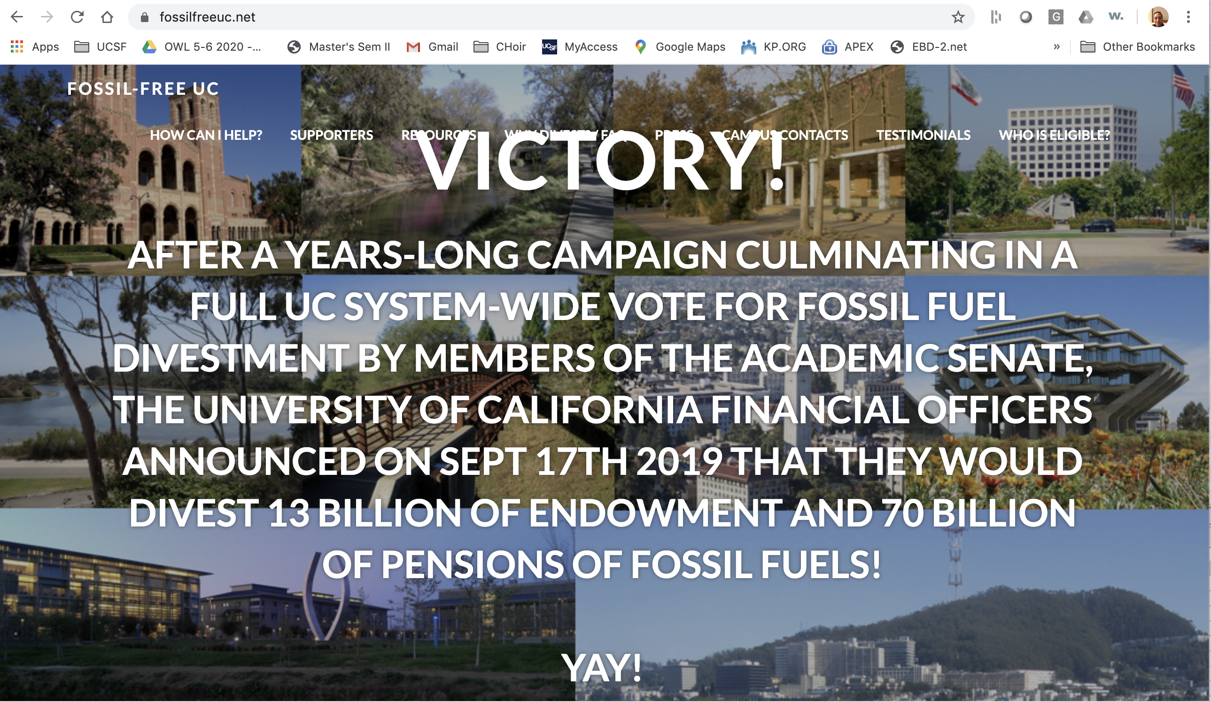
FossilFreeUC Victory

Slide 38
Relevance of Covid-19 – Silver lining
Sudden drop in GHG emissions
  Have you noticed how clear the air in the Bay Area is?
Introduced many to videoconferencing and telehealth visits
  UCSF Telehealth has gone from 2% to > 50% of visits.
Opportunity to learn from mistakes
  The argument, "We can't do what the scientists tell us to because it would be too expensive, so let’s do nothing for now" has lost some credibility.

Slide 39
We know enough to act
Given high risks and disproportionate effects, even low probability would warrant action
Interventions have co-benefits
  Reduced air pollution, environmental degradation and international conflict from extraction and burning of fossil fuels
  Better health from eating less meat and from walking and cycling rather than driving
Notes:
Source: https://www.washingtonpost.com/news/energy-environment/wp/2017/03/09/on-climate-change-scott-pruitt-contradicts-the-epas-own-website/?utm_term=.17a6087bb83d

Slide 40
Be an example for you community!
Health professionals are among the most trusts groups in every society.
Patients will notice how you get to work & manage your office
Friends and family will notice what you eat and where you go on vacation
Colleagues will notice your business travel
Notes:
Anecdote about paper towels here.

Slide 41
Summary
Climate change poses grave threats to health of people and the planet
Healthcare contributes because of its own large footprint and its costs
  Improve healthcare value
You can reduce your own environmental footprint by conserving energy, reducing travel, eating less meat, and offsetting carbon
This will not be enough. We all need to become change agents!
  JOIN A GROUP!
There are CO-BENEFITS

Slide 42

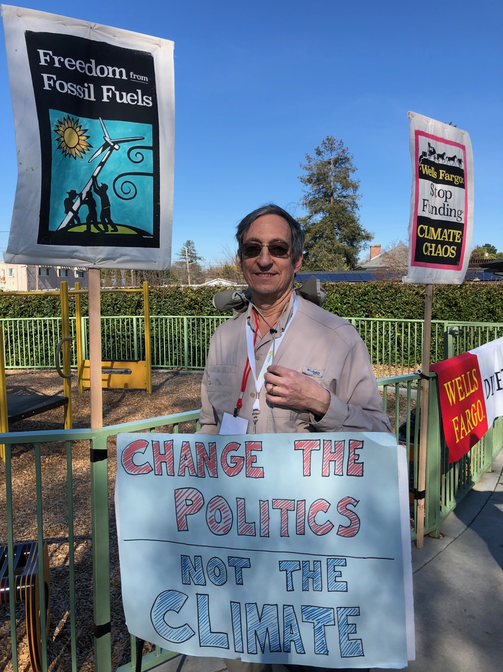
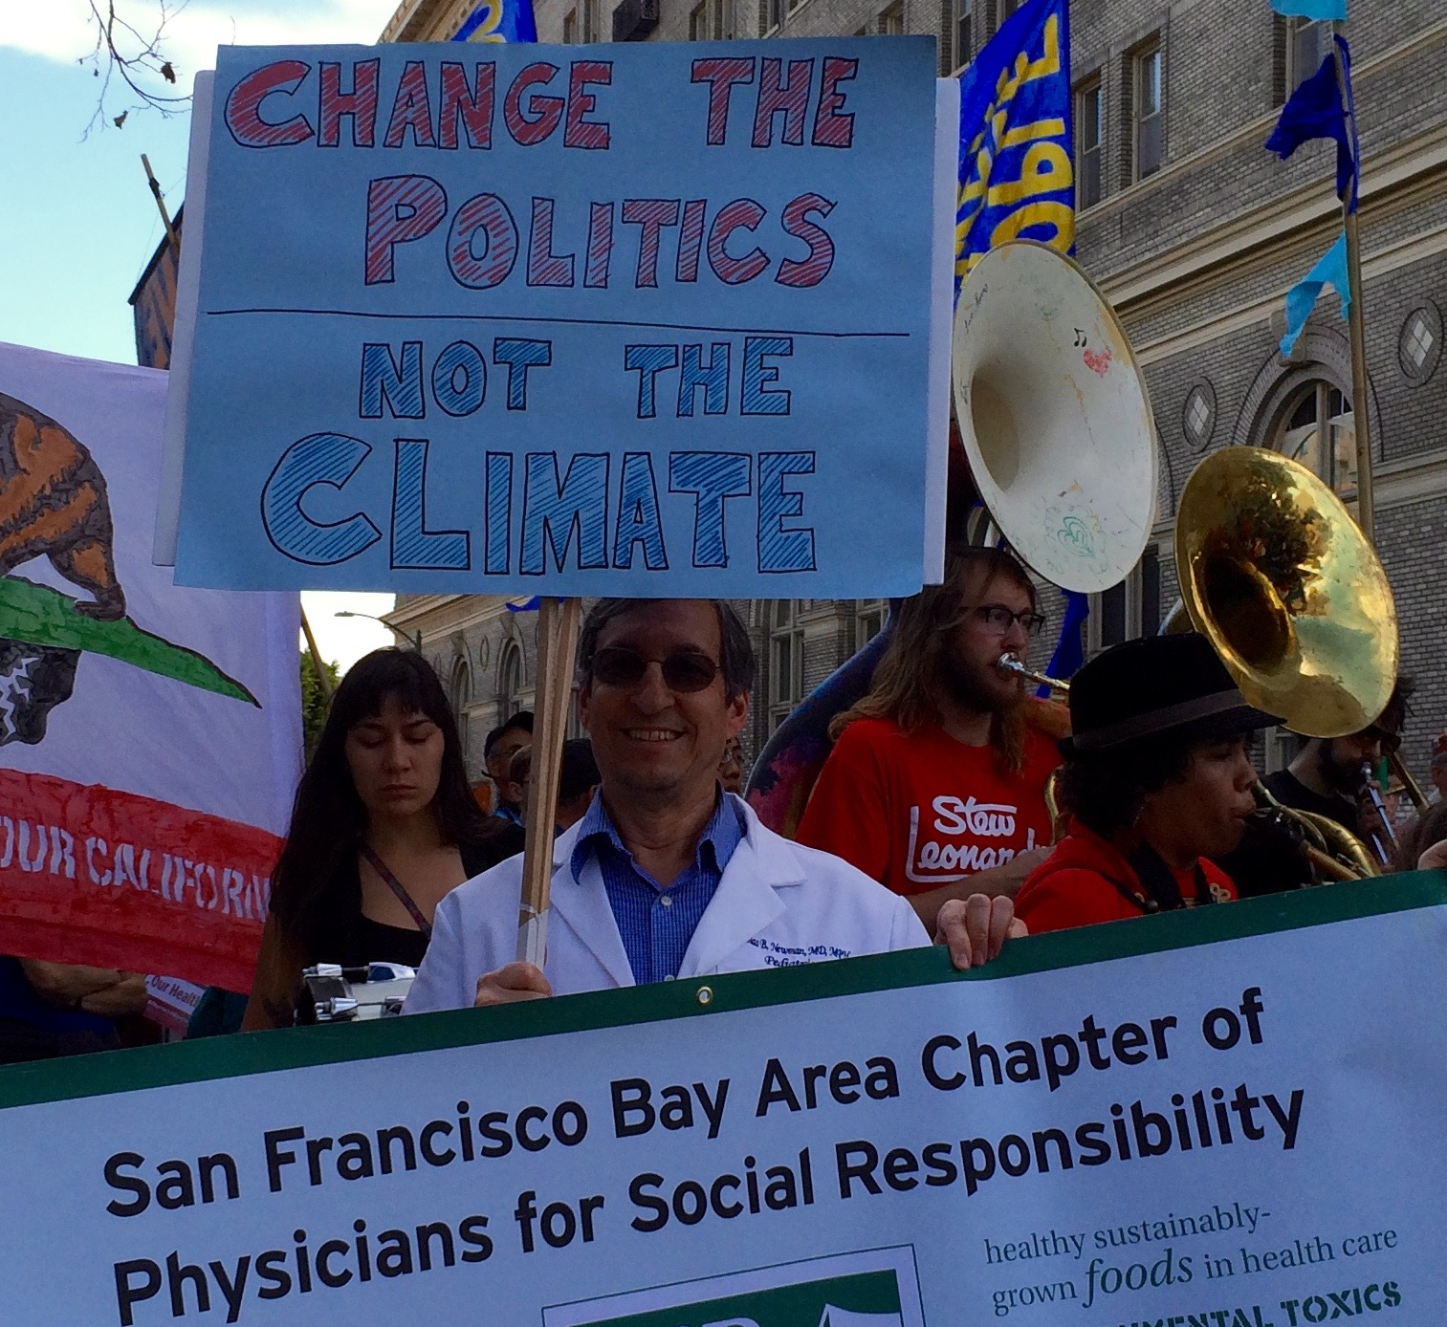
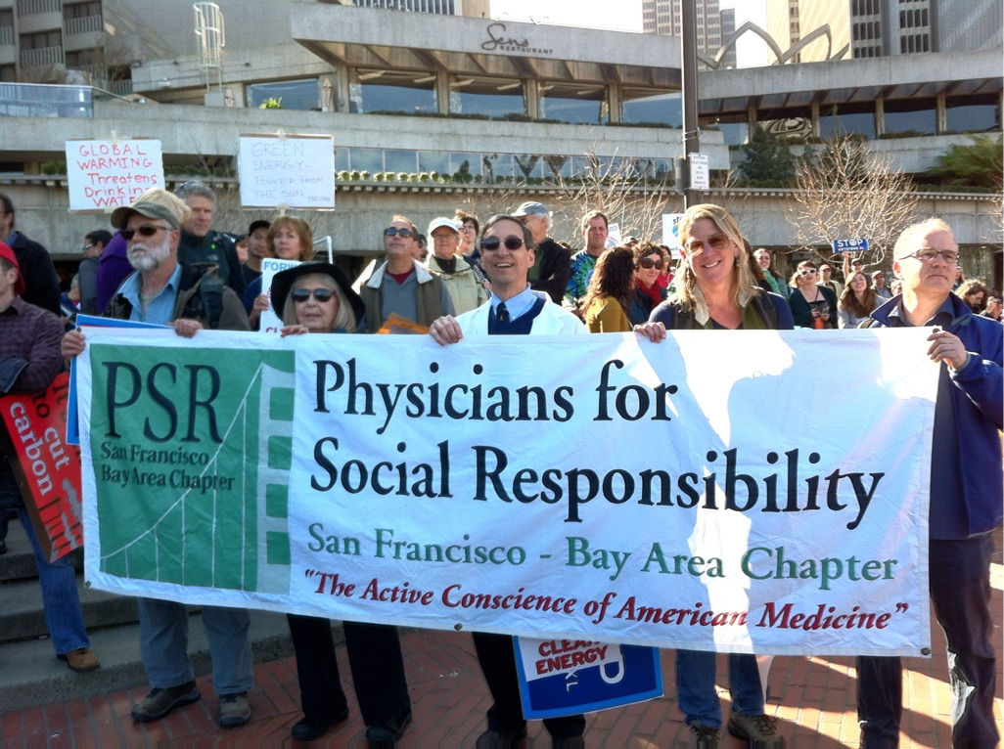
Notes:
"Oily Wells" demonstration for fossil fuel freedom and against Oily Wells Fargo bank, major lender to the fossil fuel industry. March 16, 2019. TN walked from Palo Alto to San Mateo, joined by wife for the last few miles.

